Slide 1

Machine Learning
FTW Batch 7
Week 8
Notes:
Machine learning is about extracting knowledge from data. It is a research field at the
intersection of statistics, artificial intelligence, and computer science and is also
known as predictive analytics or statistical learning. The application of machine
learning methods has in recent years become ubiquitous in everyday life. From automatic
recommendations of which movies to watch, to what food to order or which
products to buy, to personalized online radio and recognizing your friends in your
photos, many modern websites and devices have machine learning algorithms at their
core. When you look at a complex website like Facebook, Amazon, or Netflix, it is
very likely that every part of the site contains multiple machine learning models.
Outside of commercial applications, machine learning has had a tremendous influence
on the way data-driven research is done today. The tools introduced in this book
have been applied to diverse scientific problems such as understanding stars, finding
distant planets, discovering new particles, analyzing DNA sequences, and providing
personalized cancer treatments.
Your application doesn’t need to be as large-scale or world-changing as these examples
in order to benefit from machine learning, though. In this chapter, we will
explain why machine learning has become so popular and discuss what kinds of
problems can be solved using machine learning. Then, we will show you how to build
your first machine learning model, introducing important concepts along the way.

Slide 2

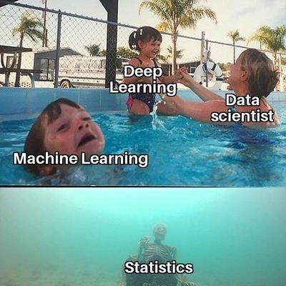
Agenda
Review
K-Means Clustering Hands-On Activity
Decision Trees for Classification
Decision Trees for Regression
Decision Trees Guided Activity
Game
Decision Tree Hands-On Activity
Classification Hands-On Activity

Slide 3
Review

Slide 4
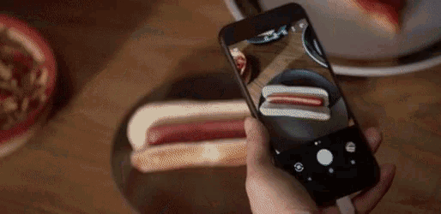
Notes:
What did you learn last week?
What are the types of machine learning problems we covered?
What ML algorithms do you already know? And what types of problems do they solve?
Are there any assumptions we’re making when we use those algorithms?

Slide 5
K-Means Clustering Hands-On Activity
B7

Slide 6
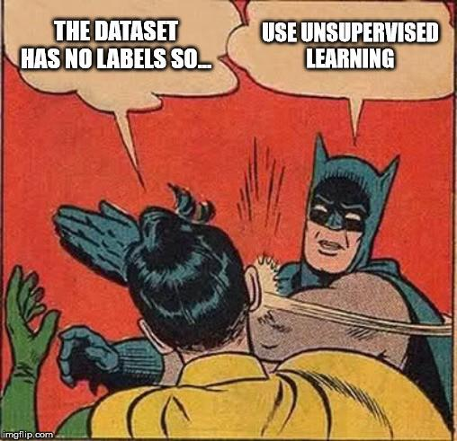
Clustering
Cluster analysis or clustering is the task of grouping a set of objects in such a way that objects in the same group (called a cluster) are more similar (in some sense) to each other than to those in other groups (clusters). It is a main task of exploratory data mining, and a common technique for statistical data analysis, used in many fields, including pattern recognition, image analysis, information retrieval, bioinformatics, data compression, computer graphics and machine learning.

Slide 7
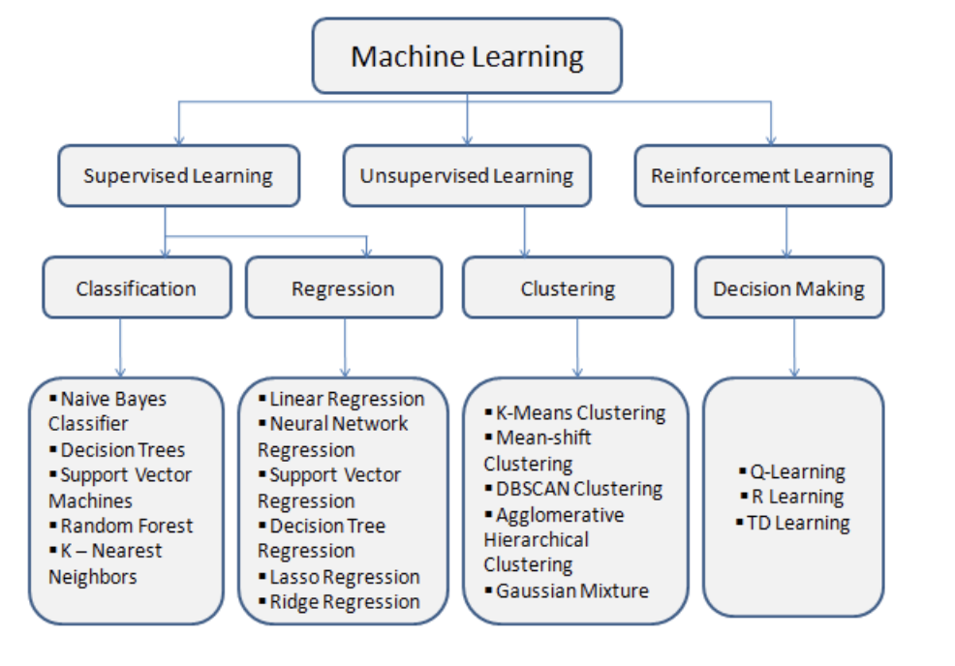
Clustering
Problems solved by Clustering
Simple Clustering Techniques
Choosing Clusters
Advanced Modelling Techniques

Slide 8
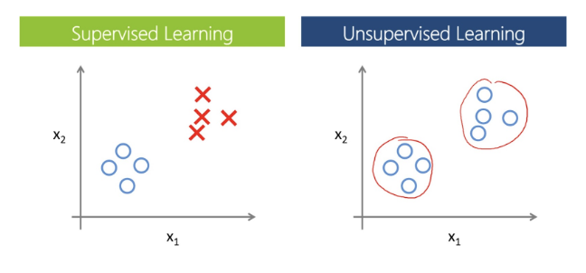
Problems Solved by Clustering

Slide 9
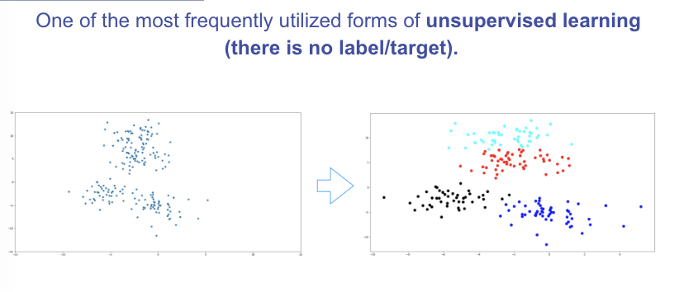
Problems Solved by Clustering
Fake news detection
Label-less fraud detection
Spam filtering
Document analysis

Slide 10
K-Means Clustering
K Means Clustering is an unsupervised learning algorithm that will attempt to group similar clusters together in your data.
So what does a typical clustering problem look like?
● Cluster Similar Documents
● Cluster Customers based on Features
● Market Segmentation
● Identify similar physical groups
Notes:
ISLR Ch10
Unlabeled data

Slide 11
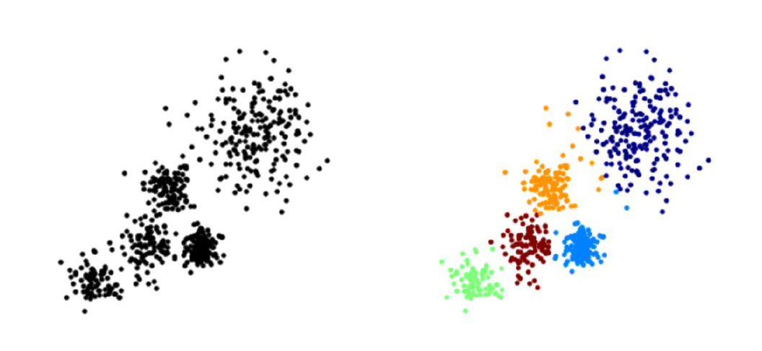
K-Means Clustering
The overall goal is to divide data into distinct groups such that observations within each group are similar
Here you can see a diagram of unlabelled training data and k means clustering trying to attempt to cluster that data into five distinct clock colored clusters.
Notes:
Here you can see a diagram of unlabelled training data and k means clustering trying to attempt to cluster
that data into five distinct clock colored clusters here.

Slide 12
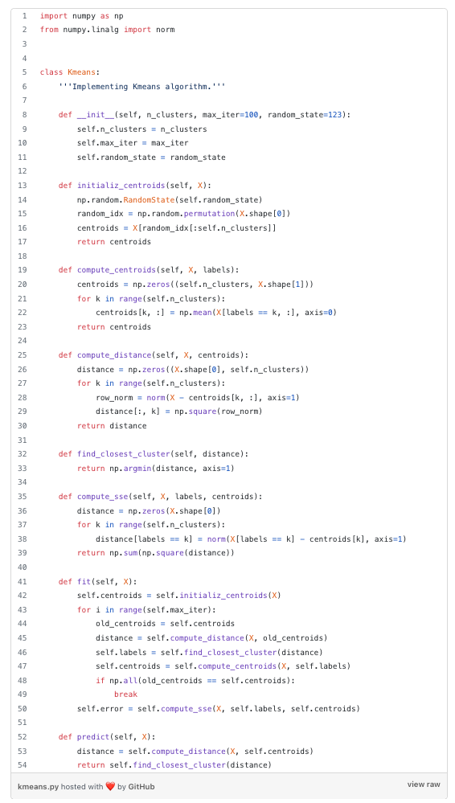
K-Means Clustering
The K Means Algorithm
● Choose a number of Clusters “K”
● Randomly assign each point to a cluster
● Until clusters stop changing, repeat the following:
○ For each cluster, compute the cluster centroid by
taking the mean vector of points in the cluster
○ Assign each data point to the cluster for which the
centroid is the closest
Notes:
How does the algorithm actually work.
Well you first choosing a number of clusters K and we'll discuss how to choose k later on then you randomly
assign each point in your data to a specific cluster then until the clusters stop changing.
You repeat the following steps for each cluster you're going to compute the cluster centroid by taking
the mean vector points in the cluster.
Then you assign each data point to the cluster for which the centroid is the closest.
Let's go ahead and take a look at the state of visualization or this plotted out visualization of k
https://towardsdatascience.com/k-means-clustering-algorithm-applications-evaluation-methods-and-drawbacks-aa03e644b48a

Slide 13
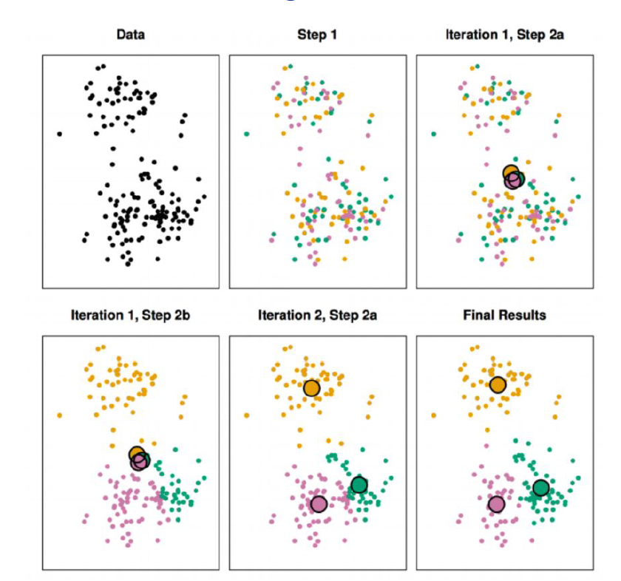
K-Means Clustering
Each observation is randomly assigned to a cluster.
Cluster centroids are computed. They are initially almost overlapping because the cluster assignments were chosen at random.
Each observation is assigned to the nearest centroid.
Find new cluster centroid and repeat prior steps until there are no new clusters, and the data points aren’t being reassigned.
Notes:
You first start off with just the observations that's shown on the top left then in top center we have
Step 1 of the algorithm.
Each observation is randomly assigned to a cluster in the top right of step 2 A The cluster centroid
are then computed.
These are shown as large colored disks.
Initially these centroid are almost completely overlapping because the initial cluster assignments were
chosen at random in the bottom left.
And step two be each observation is assigned to the nearest centroid in the bottom center.
Step two is once again perform and you can see that we've led to a new cluster centroid and we basically
keep repeating these steps until there's no new clusters meaning data points aren't being reassigned
to a new cluster centroid at the bottom right.
We have the results obtained after about 10 iterations.

Slide 14
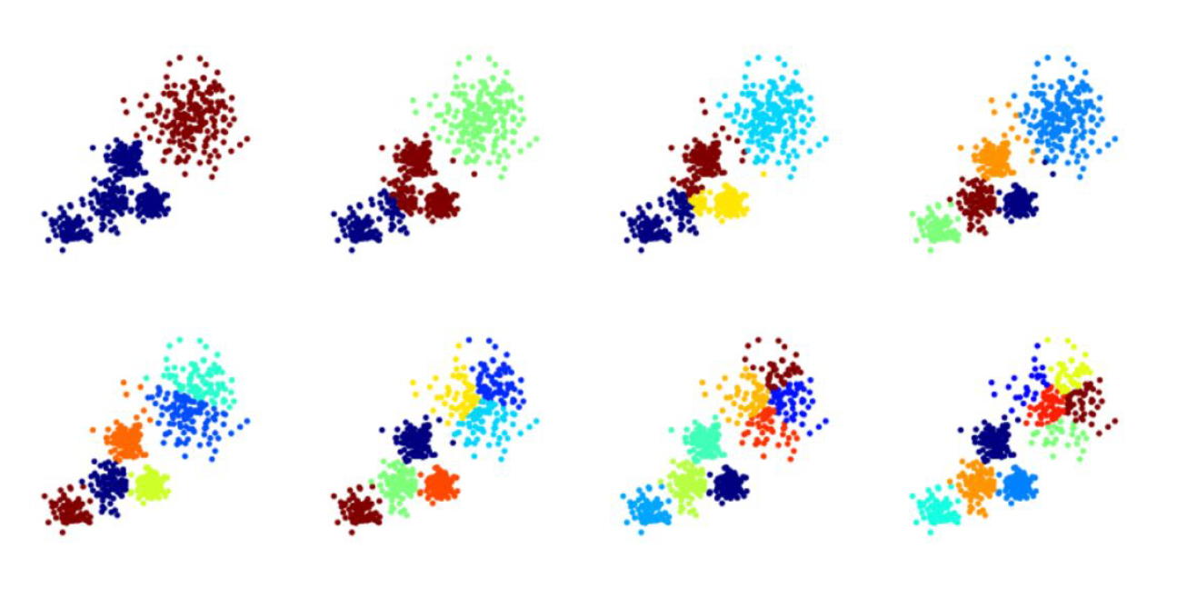
K-Means Clustering
Notes:
Let's discuss choosing a k value as we just saw to perform k means clustering.
We have to decide how many clusters we expect in the data.
The problem of selecting K isn't actually that simple.
There is no easy answer for choosing a best case value.

Slide 15
K-Means Clustering
There is no easy answer for choosing a “best” K value
One way is the elbow method
First of all, compute the sum of squared error (SSE) for some values of k (for example 2, 4, 6, 8, etc.).
The SSE is defined as the sum of the squared distance between each member of the cluster and its centroid.
If you plot k against the SSE, you will see that the error decreases as k gets larger; this is because when the number of clusters increases, they should be smaller, so distortion is also smaller.
The idea of the elbow method is to choose the k at which the SSE decreases abruptly.
This produces an "elbow effect" in the graph, as you can see in the following picture:

Slide 16
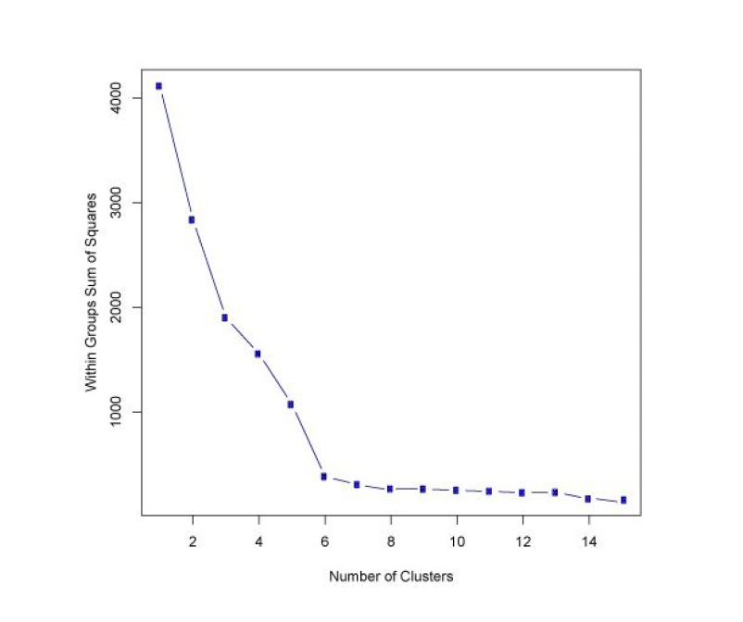
K-Means Clustering
What is the optimal number of clusters here?

Slide 17
Code Exercises
https://github.com/angelaaaateng/ftw_python/blob/main/B7_ML/KMeansClustering_Guided.ipynb
https://github.com/angelaaaateng/ftw_python/blob/main/B7_ML/K_Means_Clustering_Project.ipynb
Notes:
https://www.youtube.com/watch?v=4b5d3muPQmA&ab_channel=StatQuestwithJoshStarmer

Slide 18
Decision Trees for Classification
B7

Slide 19

What are Tree Methods?
Will my friend play tennis with me?
Notes:
ISLR Ch8
Thought experiment for motivation
What determines if someone pushes through with their plans or flakes?
Weather
Temperature
Humidity
Wind
Etc
The prince of tennis anime

Slide 20
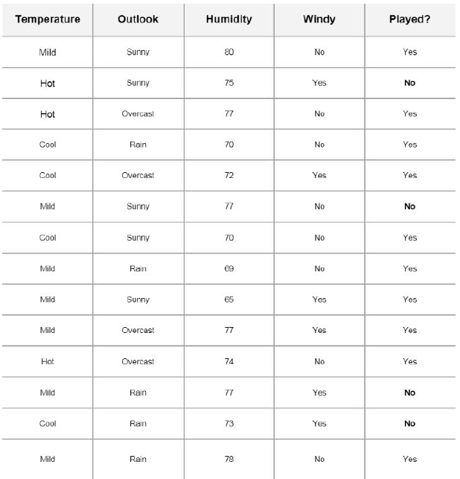
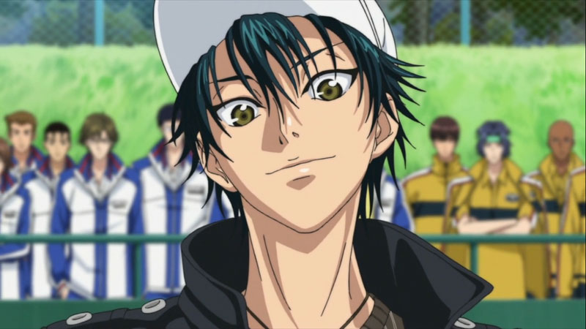
What are Tree Methods?
What “features” determine whether or not my friend flakes on me, or plays tennis with me?
How can we use this data to predict whether or not our friend will show up to play tennis with us?
Notes:
Each of these columns represents a feature and each of the rows represents a certain day.
I go ahead and for each row or day take no other features.
And finally at the final column I have a label.
Whether or not my friend came to play with me so you can see on the first day I have temperature mild
a sunny outlook.
Humidity of 80.
Windy it was not and my friend came out to play.
However in Day 2 it was a hot temperature sunny outlook 75 humidity.
It was windy and my friend did not comply with me.

Slide 21
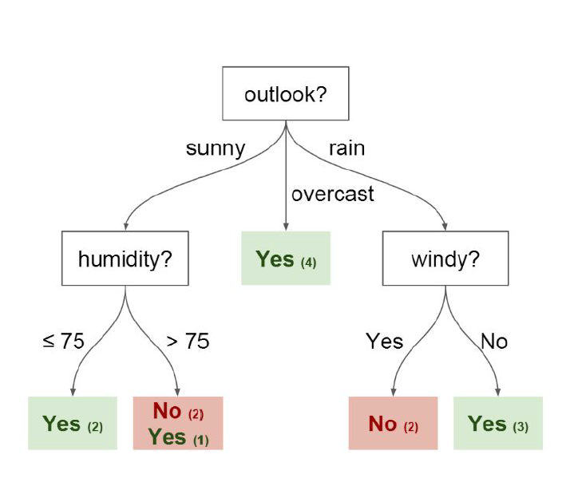
What are Tree Methods?
How can we use this data to predict whether or not our friend will show up to play tennis with us?
Decision trees are one way to do this.
Decision Tree is a supervised learning technique that can be used for both classification and regression problems

Slide 22
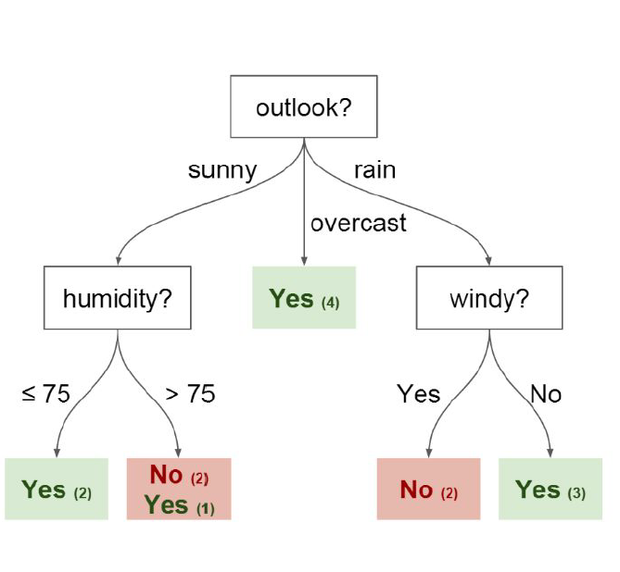
Decision Trees
Nodes - split the value of a certain attribute
Edges - outcome of a split to the next node (answer to the “question” we’re asking)
Root Node - the node that performs the first split
Leaves - terminal nodes that predict the outcome
Notes:
A decision tree is a tree-like graph with nodes representing the place where we pick an attribute and ask a question;
edges represent the answers the to the question;
and the leaves represent the actual output or class label. They are used in non-linear decision making with simple linear decision surface.

Slide 23
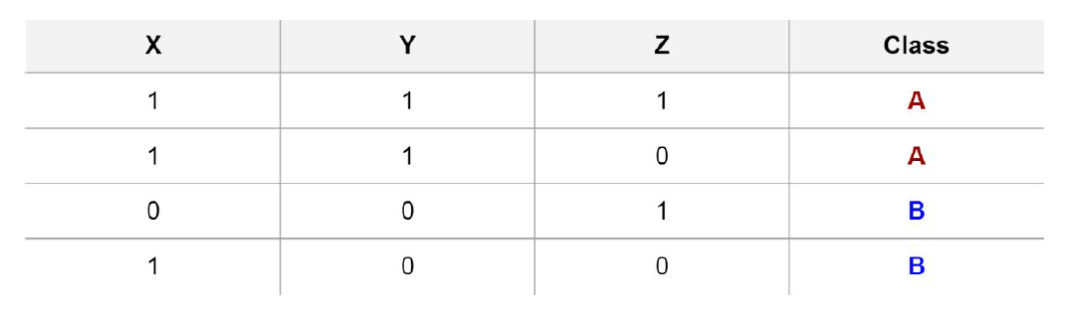
How does splitting work?
Imagine we have a dataset with 3 features → X, Y, and Z, and image that we have two possible classes for the target variable → A and B
How can we build a decision tree such that there is a lear separation between classes?
What column would you use to split the dataset into Class A and Class B?

Slide 24
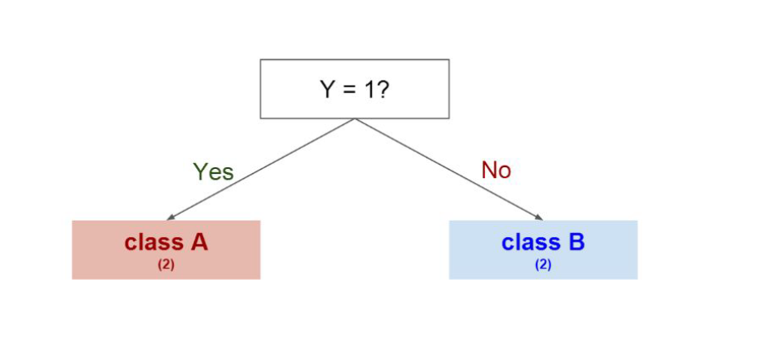
How does splitting work?
Splitting on Y gives us a clear separation between classes
Notes:
What python statement does this remind you of? (if-else statement)
The deeper the tree, the more complex the rules and the fitter the model
Decision trees classify the examples by sorting them down the tree from the root to some leaf node, with the leaf node providing the classification to the example. Each node in the tree acts as a test case for some attribute, and each edge descending from that node corresponds to one of the possible answers to the test case. This process is recursive in nature and is repeated for every subtree rooted at the new nodes.

Slide 25
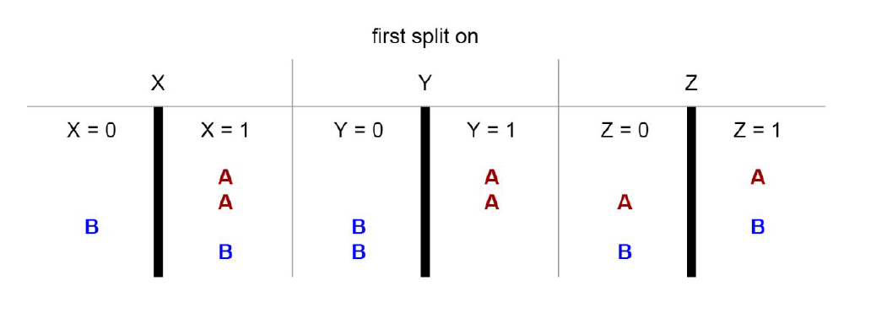
How does splitting work?
But, we could also have tried splitting our dataset on other features first, like X and Z.
What would have happened?
Notes:
Note how the Y.
Feature.
Split the classes perfectly.
And also note how the x and z features don't split the classes perfectly meaning I could have also tried
splitting on other features.
First if I split on X first or Z first.
I don't get proper separation of those classes.

Slide 26
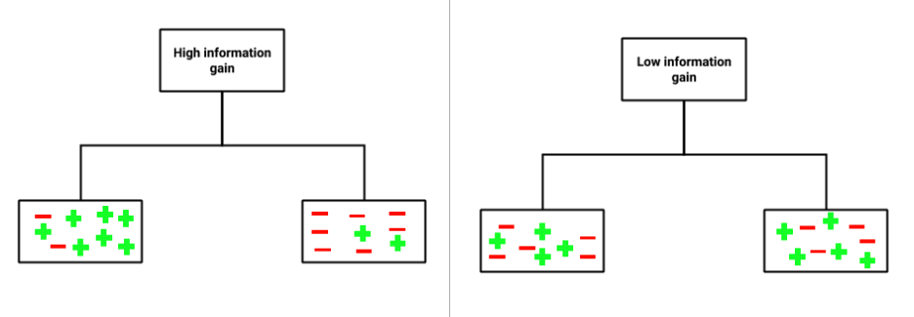
How does splitting work?
Entropy and Information Gain are the mathematical methods to choose the “best” split
Notes:
Note how the Y.
Feature.
Split the classes perfectly.
And also note how the x and z features don't split the classes perfectly meaning I could have also tried
splitting on other features.
First if I split on X first or Z first.
I don't get proper separation of those classes.
Entropy and information gain are the mathematical methods of choosing the best split.
Go ahead to refer to the reading assignment if you're interested in the mathematics behind the intuition
but the actual intuition is just trying to choose the features that best split your data.
This is called trying to maximize your information gain off of this split.
we can see that an attribute with low information gain (right) splits the data relatively evenly and as a result doesn’t bring us any closer to a decision.
Whereas, an attribute with high information gain (left) splits the data into groups with an uneven number of positives and negatives and as a result helps in separating the two from each other.
entropy that measures the level of impurity in a group of examples.
Note that entropy is 0 if all the members of S belong to the same class.
Entropy is 1 when the sample contains an equal number of positive and negative examples. If the sample contains unequal number of positive and negative examples, entropy is between 0 and 1.
Information gain calculates how much information a feature provides us about a class.
Maximize information gain, minimize entropy
The entropy is a measure of uncertainty associated with our data. We can intuitively think that if a data set had only one label (e.g. every passenger survived), then we have a low entropy. So we would like to split our data in a way that minimizes the entropy.
https://towardsdatascience.com/enchanted-random-forest-b08d418cb411#.hh7n1co54

Slide 27
Advantages and Disadvantages of Decision Trees
ADVANTAGES
Easy to understand
Can handle both categorical and numerical data
Resistant to outliers, hence requires less data preprocessing
New features can be added easily
Can be used to build larger classifiers by using ensemble methods
DISADVANTAGES
Prone to overfitting
Requires some kind of measurement to determine “how well” the trees / the algorithm is doing
Parameter tuning can be difficult
Can create biased trees if some classes dominate
Notes:
Note how the Y.
Feature.
Split the classes perfectly.
And also note how the x and z features don't split the classes perfectly meaning I could have also tried
splitting on other features.
First if I split on X first or Z first.
I don't get proper separation of those classes.
Entropy and information gain are the mathematical methods of choosing the best split.
Go ahead to refer to the reading assignment if you're interested in the mathematics behind the intuition
but the actual intuition is just trying to choose the features that best split your data.
This is called trying to maximize your information gain off of this split.
we can see that an attribute with low information gain (right) splits the data relatively evenly and as a result doesn’t bring us any closer to a decision.
Whereas, an attribute with high information gain (left) splits the data into groups with an uneven number of positives and negatives and as a result helps in separating the two from each other.
entropy that measures the level of impurity in a group of examples.
Note that entropy is 0 if all the members of S belong to the same class.
Entropy is 1 when the sample contains an equal number of positive and negative examples. If the sample contains unequal number of positive and negative examples, entropy is between 0 and 1.
https://www.hackerearth.com/practice/machine-learning/machine-learning-algorithms/ml-decision-tree/tutorial/#:~:text=determine%20its%20performance-,Introduction,with%20simple%20linear%20decision%20surface.

Slide 28
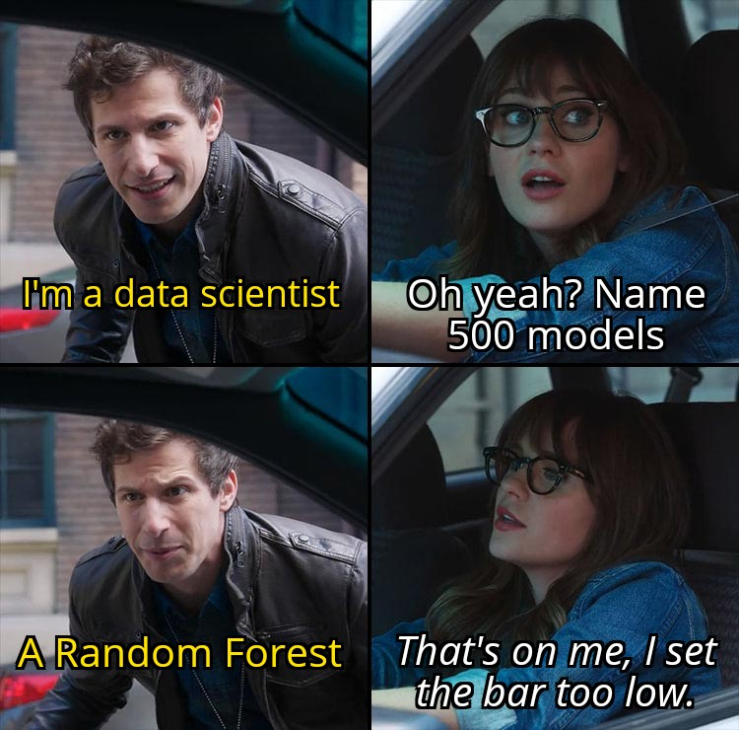
Random Forests
However, decision trees often have high variance → different splits can lead to different trees (random_seed)
To improve performance, we can use many trees with a random sample of features chosen as the split.
A random forest utilizes ensemble learning, which is a technique that combines many classifiers to provide solutions to complex problems
Random forest algorithm → many decision trees
How does this work?
A new random sample of features is chosen for every tree at every split
Notes:
Now let's talk about random force as a way to improve performance off single decision trees.
The primary weakness of decision trees is that they don't tend to have the best predictive accuracy
.
This is partially due to the high variance meaning that different splits in the training data can lead
to very different trees.
Bagging is a general purpose procedure for reducing the variance of machine learning method
We can build off the idea of bagging by utilizing random force random force.
It's just a slight variation of these bag to trees that has even better performance.
Which is what we're going to be discussing and coding out in our what we do of a random forest as we
create an ensemble of decision trees using bootstrap samples of the training set bootstrap samples of
the training set just means sampling from the training set with replacement.
However we're building each tree each time a split is considered a random sample of M features is chosen
as a split candidate from the full set of p features.
The split is only allowed to use one of those m features a new random sample of features is chosen for
every single tree every single split for classification.
This M. random sample of M features is typically chosen to be the square root of P where P is the full
set of features.
You may be wondering what's the point of using random force.
Well suppose there is one very strong feature in the data set a feature that's really strong at predicting
a certain class when using bagged trees.
That's that bootstrap sampling.
Most of the trees will use that feature as the top split that's going to result in ensemble of really
similar trees that are highly correlated which is something you want to avoid averaging highly correlated
quantities does not significantly reduce variance.
I randomly leaving out candidate features from each split random force are going to Dijk correlate to
trees.
Meaning making the trees in the pendant of each other such that the averaging process can reduce the
variance of the resulting model.
So we won't be affected by features that really strongly predict declasse data.
Now that we've taken a look at the theoretical background behind this isn't trees in random force.
Bagging
Boostrapped samples → sampling with replacement
- For classification, m is typically chosen to be the
square root of p.

Slide 29
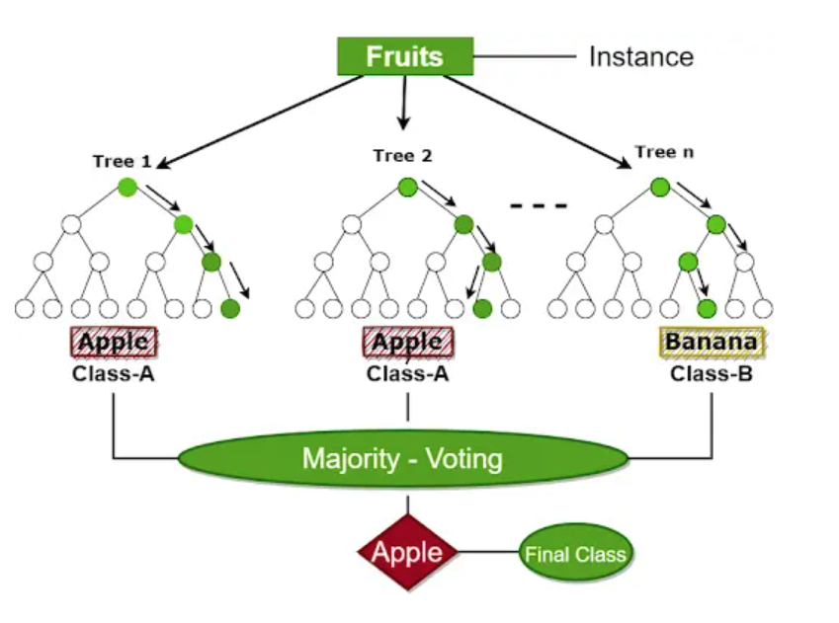
Random Forests
What if there’s one very strong feature in the dataset?
When we use decision trees, most of the trees may use that feature as the “top split” since it separates the data most clearly.
However, if we have an ensemble of similar trees that do this, this could result in decision trees that are highly correlated.
So, we can randomly leave out features from each split to “decorrelate” the trees.
This way, the “averaging” process can more effectively reduce the variance of the resulting model.
Notes:
Now let's talk about random force as a way to improve performance off single decision trees.
The primary weakness of decision trees is that they don't tend to have the best predictive accuracy
.
This is partially due to the high variance meaning that different splits in the training data can lead
to very different trees.
Bagging is a general purpose procedure for reducing the variance of machine learning method
We can build off the idea of bagging by utilizing random force random force.
It's just a slight variation of these bag to trees that has even better performance.
Which is what we're going to be discussing and coding out in our what we do of a random forest as we
create an ensemble of decision trees using bootstrap samples of the training set bootstrap samples of
the training set just means sampling from the training set with replacement.
However we're building each tree each time a split is considered a random sample of M features is chosen
as a split candidate from the full set of p features.
The split is only allowed to use one of those m features a new random sample of features is chosen for
every single tree every single split for classification.
This M. random sample of M features is typically chosen to be the square root of P where P is the full
set of features.
You may be wondering what's the point of using random force.
Well suppose there is one very strong feature in the data set a feature that's really strong at predicting
a certain class when using bagged trees.
That's that bootstrap sampling.
Most of the trees will use that feature as the top split that's going to result in ensemble of really
similar trees that are highly correlated which is something you want to avoid averaging highly correlated
quantities does not significantly reduce variance.
I randomly leaving out candidate features from each split random force are going to Dijk correlate to
trees.
Meaning making the trees in the pendant of each other such that the averaging process can reduce the
variance of the resulting model.
So we won't be affected by features that really strongly predict declasse data.
Now that we've taken a look at the theoretical background behind this isn't trees in random force.
Bagging
Boostrapped samples → sampling with replacement
- For classification, m is typically chosen to be the
square root of p.

Slide 30
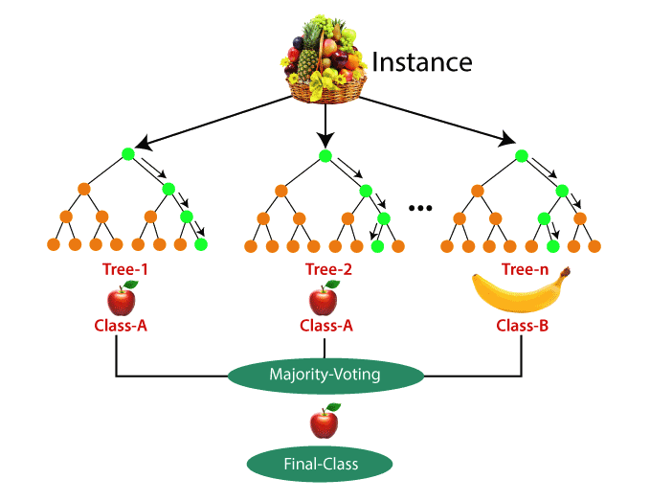
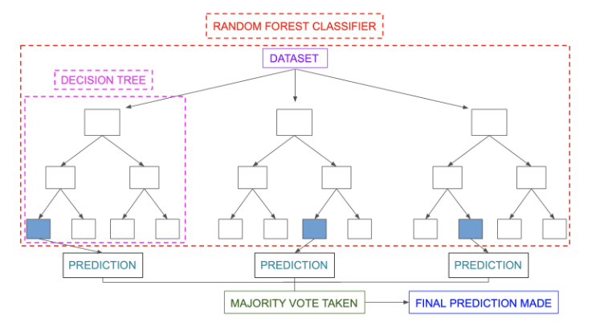
Random Forests
Notes:
Now let's talk about random force as a way to improve performance off single decision trees.
The primary weakness of decision trees is that they don't tend to have the best predictive accuracy
.
This is partially due to the high variance meaning that different splits in the training data can lead
to very different trees.
Bagging is a general purpose procedure for reducing the variance of machine learning method
We can build off the idea of bagging by utilizing random force random force.
It's just a slight variation of these bag to trees that has even better performance.
Which is what we're going to be discussing and coding out in our what we do of a random forest as we
create an ensemble of decision trees using bootstrap samples of the training set bootstrap samples of
the training set just means sampling from the training set with replacement.
However we're building each tree each time a split is considered a random sample of M features is chosen
as a split candidate from the full set of p features.
The split is only allowed to use one of those m features a new random sample of features is chosen for
every single tree every single split for classification.
This M. random sample of M features is typically chosen to be the square root of P where P is the full
set of features.
You may be wondering what's the point of using random force.
Well suppose there is one very strong feature in the data set a feature that's really strong at predicting
a certain class when using bagged trees.
That's that bootstrap sampling.
Most of the trees will use that feature as the top split that's going to result in ensemble of really
similar trees that are highly correlated which is something you want to avoid averaging highly correlated
quantities does not significantly reduce variance.
I randomly leaving out candidate features from each split random force are going to Dijk correlate to
trees.
Meaning making the trees in the pendant of each other such that the averaging process can reduce the
variance of the resulting model.
So we won't be affected by features that really strongly predict declasse data.
Now that we've taken a look at the theoretical background behind this isn't trees in random force.
Bagging
Boostrapped samples → sampling with replacement
- For classification, m is typically chosen to be the
square root of p.
Average for regression, or majority vote for classification

Slide 31
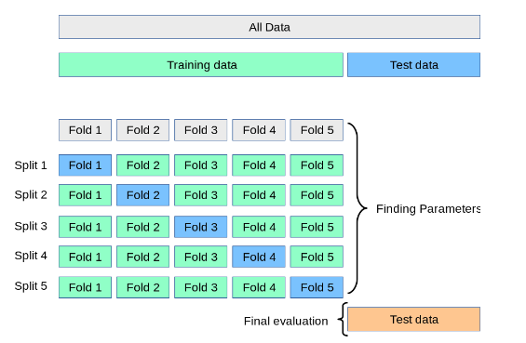
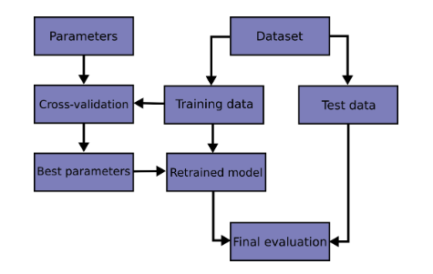
As an aside: Cross Validation
Notes:
https://scikit-learn.org/stable/modules/cross_validation.html

Slide 32
Decision Trees for Regression
B7

Slide 33

How can we use decision trees for regression?
How many goals will a player score during a hockey game?
Notes:
Decision trees are a game of 20 questions on your dataset.
Hockey players
We’re trying to predict
512 = the whole training dataset (samples)
Value =
Goal of this process: build a decision tree that predicts the number of goals a player will score over the course of a hockey game
Supinamarada!

Slide 34
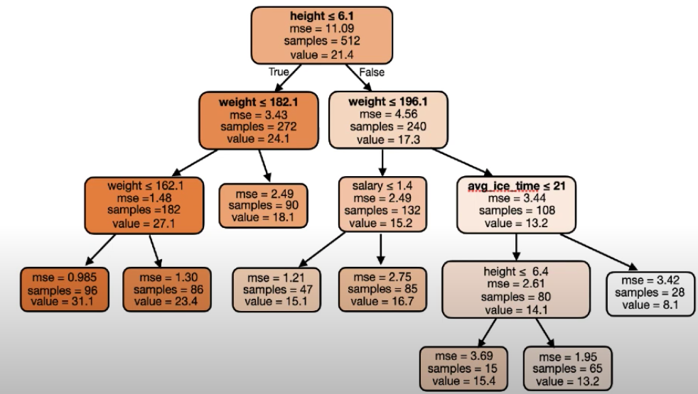
How can we use decision trees for regression?
How many goals will a player score during a hockey game?
Notes:
Decision trees are a game of 20 questions on your dataset.
Hockey players
We’re trying to predict
512 = the whole training dataset (samples)
Value = the average value of the number of goals in a season → the average of the things we’re trying to predict
Goal of this process: build a decision tree that predicts the number of goals a player will score over the course of a hockey game
MSE = mean squared error → how wrong on average we are in terms of regression
How wrong on average in our dataset
How do we get MSE when we have no “model”
Statistical average → ML Doesn’t need to be super complicated
The average is a model → more data = improves accuracy
Bucket 1 ⇒ on average, hockey players are scoring 21.4 goals
If we pick a hockey player at random, how many goals would he make, and how different is that from the “average’. You’ll be wrong by 11.09. How bad the average is as a predictor
Seems like they’re all spread out, we don’t expect hockey players to score near the mean.

Slide 35
How can we use decision trees for regression?
We have 512 hockey players
The average number of goals scored by those 512 hockey players is 21.4 goals per game
If we pick a player at random from those 512 hockey player bucket, we’ll be wrong / off from the average by a mean squared error of 11.09.
Notes:
Decision trees are a game of 20 questions on your dataset.
Hockey players
We’re trying to predict
512 = the whole training dataset (samples)
Value = the average value of the number of goals in a season → the average of the things we’re trying to predict
Goal of this process: build a decision tree that predicts the number of goals a player will score over the course of a hockey game
MSE = mean squared error → how wrong on average we are in terms of regression
How wrong on average in our dataset
How do we get MLE when we have no “model”
Statistical average → ML Doesn’t need to be super complicated
The average is a model → more data = improves accuracy
Bucket 1 ⇒ on average, hockey players are scoring 21.4 goals
If we pick a hockey player at random, how many goals would he make, and how different is that from the “average’. You’ll be wrong by 11.09. How bad the average is as a predictor
Seems like they’re all spread out, we don’t expect hockey players to score near the mean.
Low mse means we can tell a lot about the players in the bucket if we know the average

Slide 36
How can we use decision trees for regression?
If a hockey player has a height less than or equal to 6.1, go to the left node. Else, go to the right node.
Let’s check our math. The samples from the leaf node should sum up to the samples in the root node.
Value = average number of goals scored by hockey players in that given bucket.
What information can we glean from the average number of goals scored by hockey players based on height?
How can we interpret the MSE in these buckets/nodes?
The MSE of the leaf nodes decreased, when compared to the root node.
The average is now a better predictor.
Notes:
What information can we glean from the average number of goals scored by hockey players based on height? → could they be inversely correlated?
On average, if we take a random player from the bucket, let’s just assume that the number of goals he scores is the average → which is 24.1 goals. How wrong would we be? We’d be wrong by a mean squared error of 3.43 on average.
The MSEs have decreased. The average is now a better guess for the true number of goals scored by these hockey players.
The tree split this in such a way that the average is a better predictor.
The lower the MSE is, the better of a job we’ve done in terms of asking a question here.
This is what happens with a decision tree. But how can we use two different values in terms of one question to ask (ie. we have 2 mses)
How do we get a single number for “purity” that combines these two MSEs together
You need a single number → that tells us how good or bad a given question is.
Weighted average.
When would we get an MSE = 0? Could this be caused by a “weird” question that overfits? What are some types of questions we could ask that show “overfitting” and give us an MSE = 0?
WEIGHTED AVERAGE

Slide 37
How can we use decision trees for regression?
Repeat this process of “asking the right questions” that minimizes the weighted average of the MSE.
When we reach the leaf node at the end of the tree, what would our prediction be at that node? How many goals do we think the hockey player will score?
Notes:
When we reach the leaf node at the end of the tree, what would our prediction be at that node? How many goals do we think the hockey player will score?
This would just be the mean
We’ve been trying to make sure that the mean is a good representation of each bucket.
He will score 15.1 goals in one game → this is the prediction
We get other really cool information
Mean squared error → how bad this value is as an estimate for the true number of goals that each individual player will score
MSE → an estimate of how confident you should be in terms of the number of goals that you think each player who ends up in this bucket will score.
You can make a prediction, and based on the factors of the player, I can tell you not only the number of goals that I think he will score, but also how confidente I am in my own estimate.
How many samples ended up in a given bucket during training. This will allow us to spot buckets with smaller samples. → how are our training samples distributed and how interested we should be.
You are constrained to the number of leaf nodes we have. Finite number of buckets.
Regression tree!

Slide 38
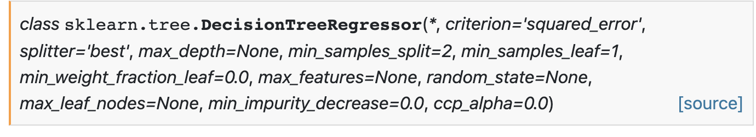
How can we use decision trees for regression?
How do we prevent overfitting in decision trees?
Set the max_depth
Remember that this is a game of “20 Questions” and not “Infinity Questions”
I.e. you don’t want to get to a point where you have one sample per node
Alternatively, we could also set the max_leaf_nodes to determine the same thing (i.e. number of leaf nodes cannot exceed those n results)
Set the min_sample_split
Minimum number of samples in a bucket in order to justify splitting that bucket
Notes:
When we reach the leaf node at the end of the tree, what would our prediction be at that node? How many goals do we think the hockey player will score?
This would just be the mean
We’ve been trying to make sure that the mean is a good representation of each bucket.
He will score 15.1 goals in one game → this is the prediction
We get other really cool information
Mean squared error → how bad this value is as an estimate for the true number of goals that each individual player will score
MSE → an estimate of how confident you should be in terms of the number of goals that you think each player who ends up in this bucket will score.
You can make a prediction, and based on the factors of the player, I can tell you not only the number of goals that I think he will score, but also how confidente I am in my own estimate.
How many samples ended up in a given bucket during training. This will allow us to spot buckets with smaller samples. → how are our training samples distributed and how interested we should be.
You are constrained to the number of leaf nodes we have. Finite number of buckets.
Regression tree!

Slide 39
Decision Trees Guided Activity
https://github.com/angelaaaateng/ftw_python/blob/main/B7_ML/DecisionTrees.ipynb
Notes:
https://github.com/angelaaaateng/ftw_python/blob/main/B7_ML/DecisionTrees.ipynb

Slide 40
Decision Trees Hands-On Activity
https://github.com/angelaaaateng/ftw_python/blob/main/B7_ML/DecisionTree_Project.ipynb
Notes:
https://github.com/angelaaaateng/ftw_python/blob/main/B7_ML/DecisionTree_Project.ipynb

Slide 41
Multiclass Classification Hands-On Activity
B7

Slide 42
Forest Cover Type Prediction
Predict the forest cover type (the predominant kind of tree cover) from strictly cartographic variables (as opposed to remotely sensed data). The actual forest cover type for a given 30 x 30 meter cell was determined from US Forest Service (USFS) Region 2 Resource Information System data. Independent variables were then derived from data obtained from the US Geological Survey and USFS. The data is in raw form (not scaled) and contains binary columns of data for qualitative independent variables such as wilderness areas and soil type.
This study area includes four wilderness areas located in the Roosevelt National Forest of northern Colorado. These areas represent forests with minimal human-caused disturbances, so that existing forest cover types are more a result of ecological processes rather than forest management practices.
https://raw.githubusercontent.com/angelaaaateng/ftw_python/main/data/covertype_train.csv

Slide 43
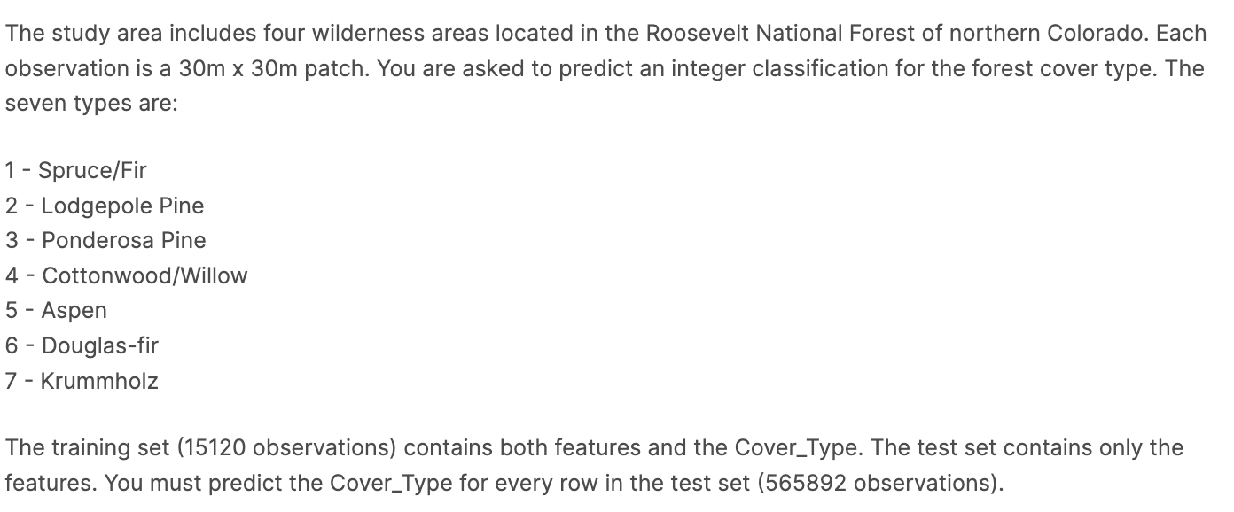
Forest Cover Type Prediction

Slide 44
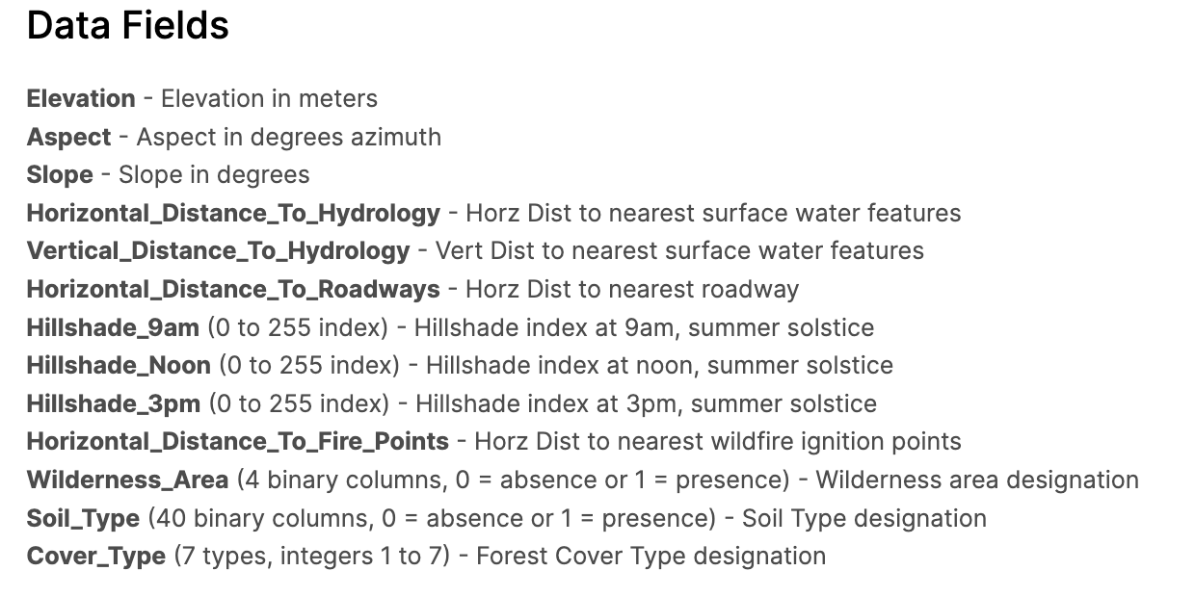
Forest Cover Type Prediction
https://www.kaggle.com/competitions/forest-cover-type-prediction/data
Notes:
https://medium.com/towards-data-science/dealing-with-multiclass-data-78a1a27c5dcc
https://github.com/angelaaaateng/Projects/blob/master/Covertype_Prediction/Scripts/Tree-Based%20and%20Bagging%20Methods.ipynb

Slide 45
Introduction to Github
B7

Slide 46
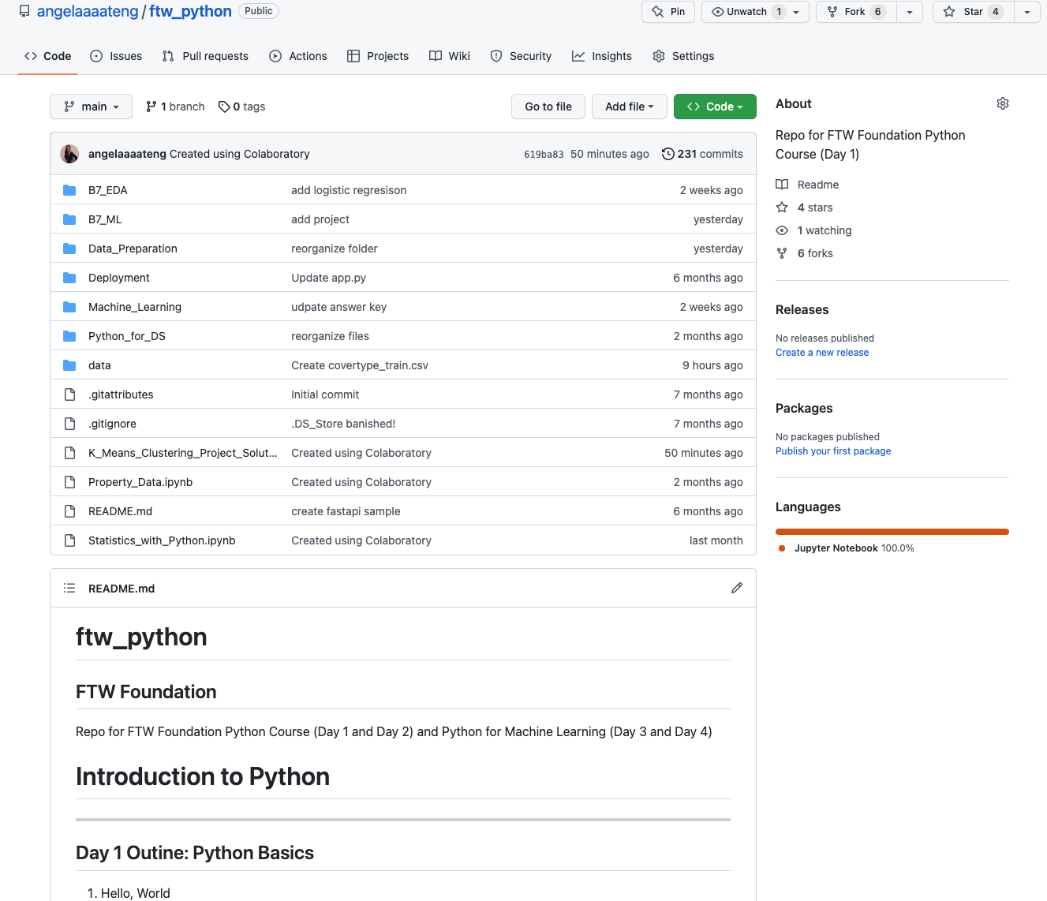
Github Hello World
https://docs.github.com/en/get-started/quickstart/hello-world

Slide 47
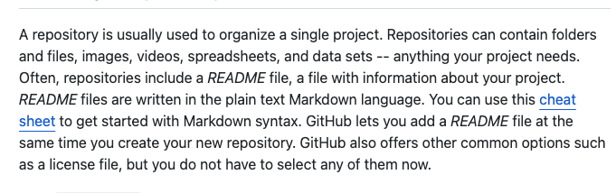
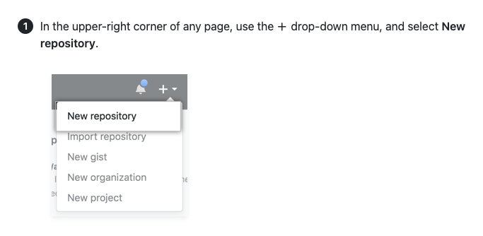
Github Hello World

Slide 48
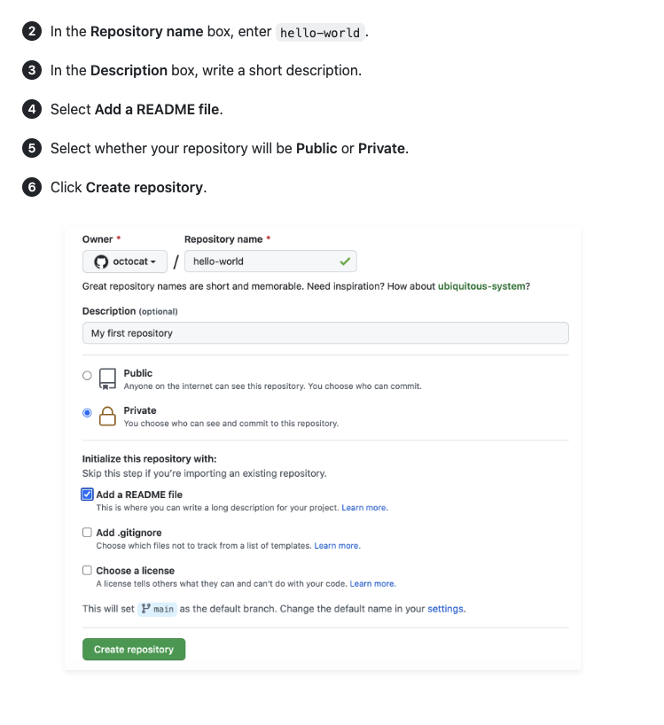
Github Hello World

Slide 49
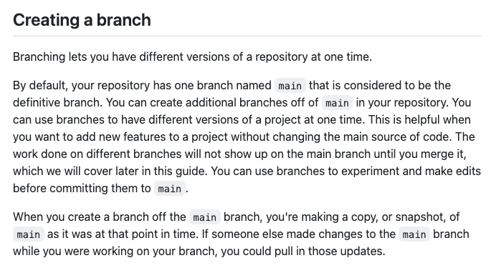
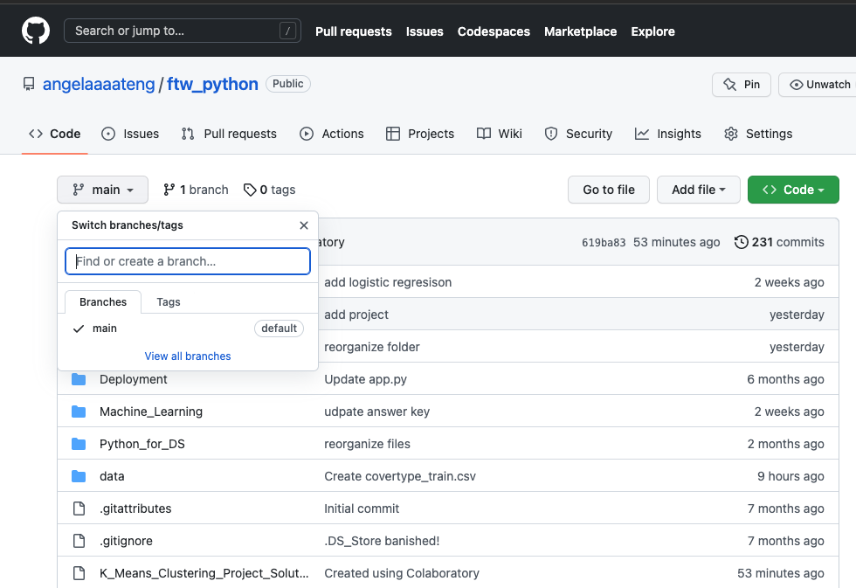
Github Hello World

Slide 50
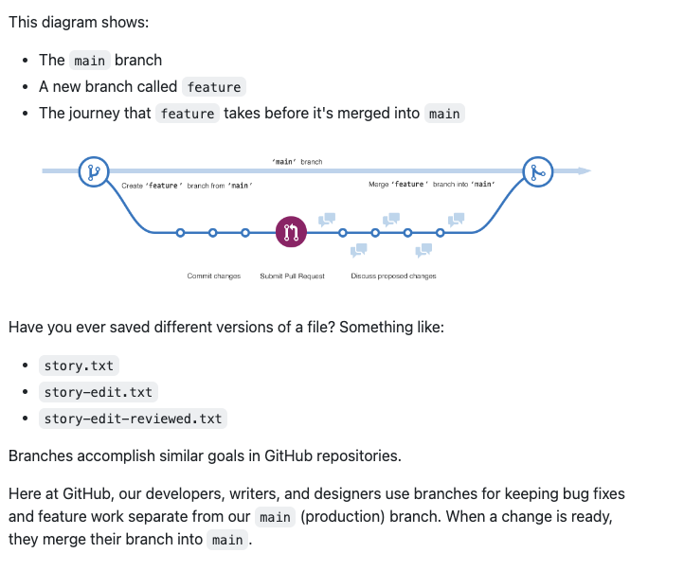
Github Hello World

Slide 51
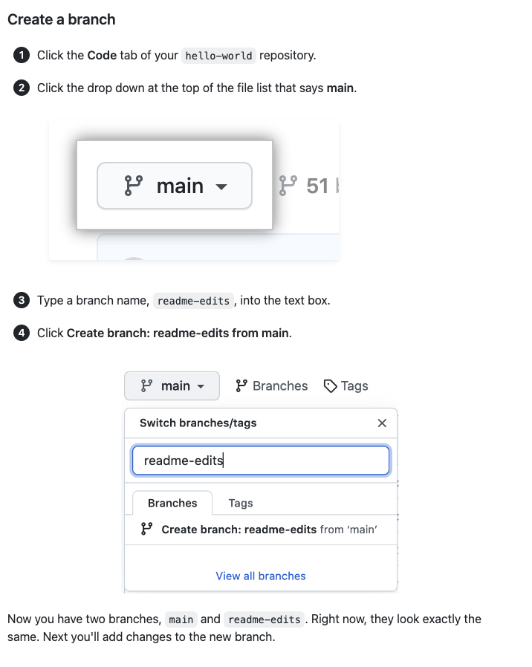
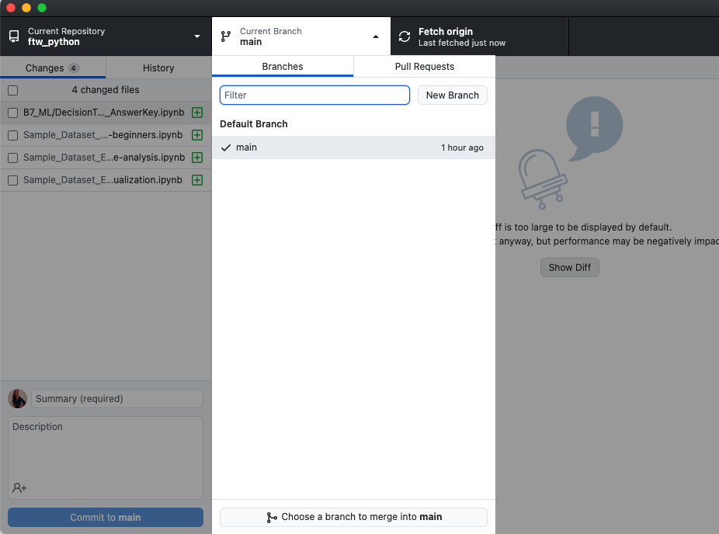
Github Hello World

Slide 52
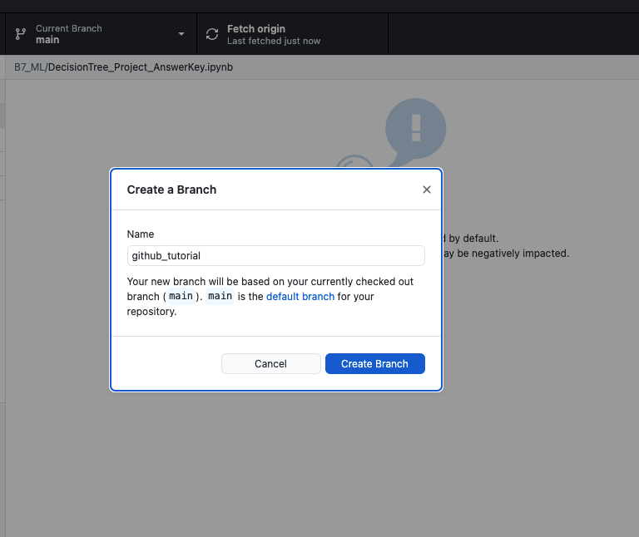
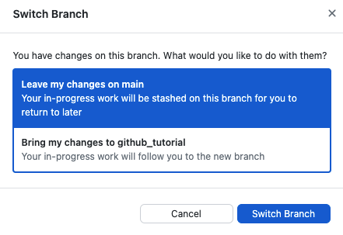
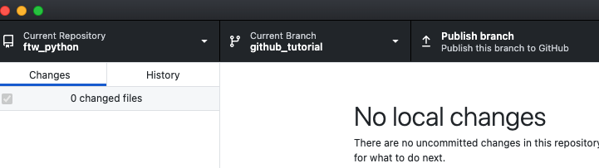
Github Hello World

Slide 53
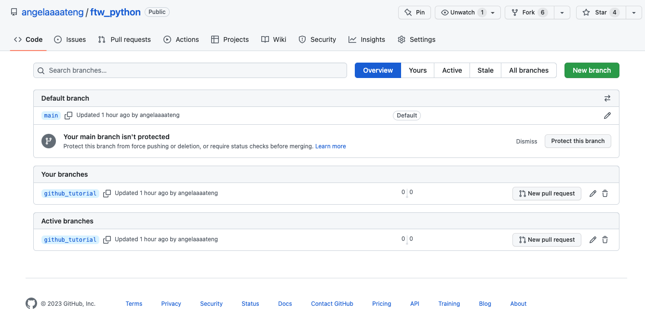
Github Hello World

Slide 54
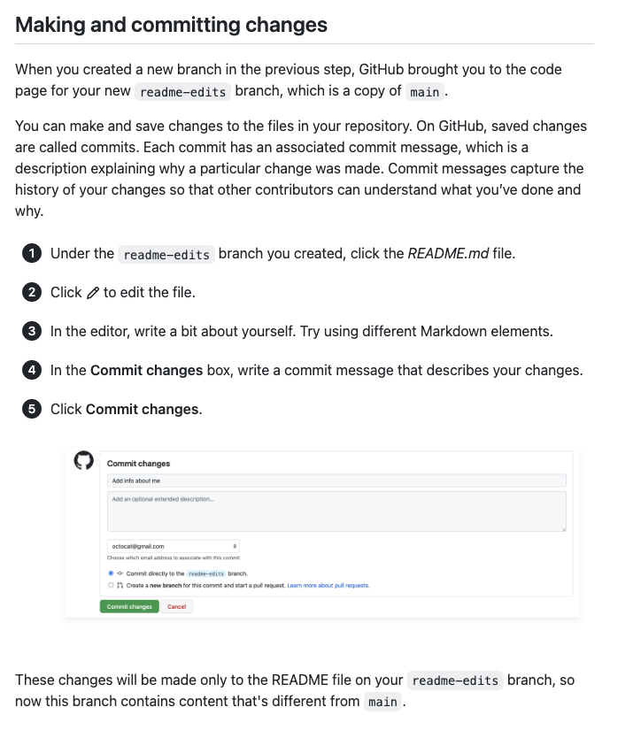
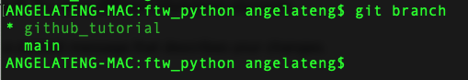
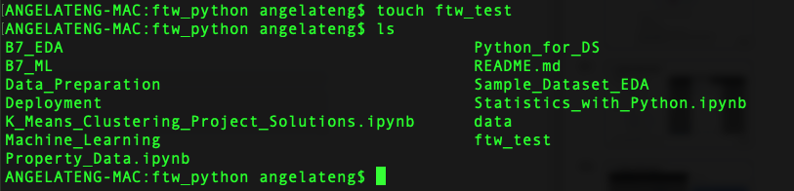
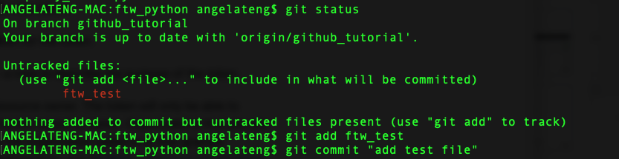
Github Hello World

Slide 55
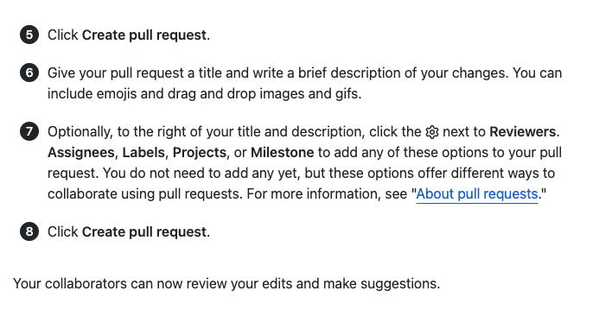
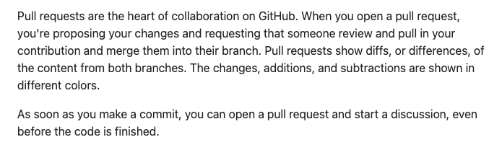
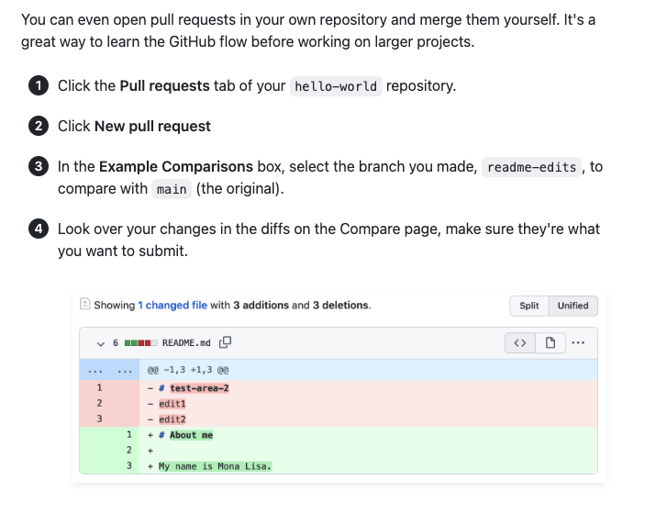
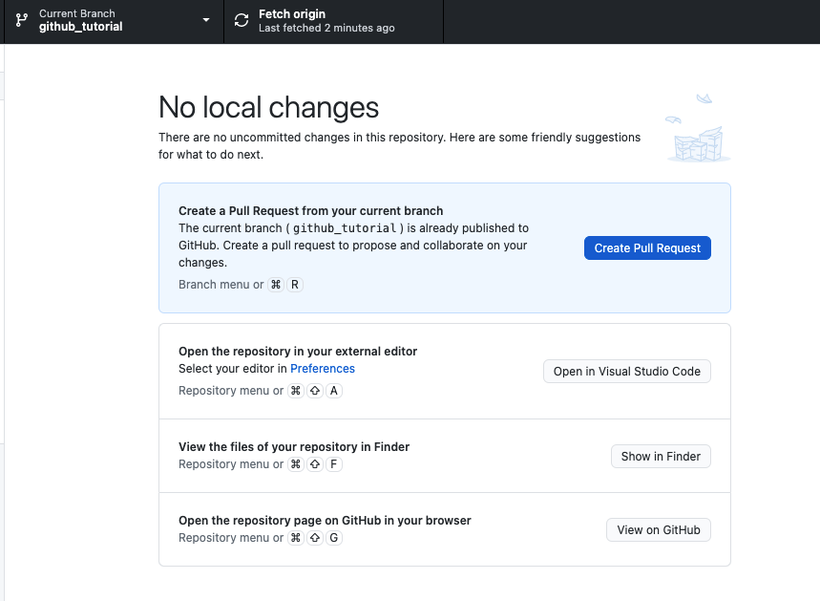
Github Hello World

Slide 56


Github Hello World

Slide 57

Github Hello World
Notes:
https://gist.github.com/brandon1024/14b5f9fcfd982658d01811ee3045ff1e

Slide 58
Thank you :)

